Slide 1
NUCLEAR AND QUANTUM PHYSICS

Slide 2
E Nuclear and Quantum Physics
E.1 Structure of The Atom
E.2 Quantum Physics
E.3 Radioactive Decay
E.4 Fission
E.5 Fusion and Stars

Slide 3
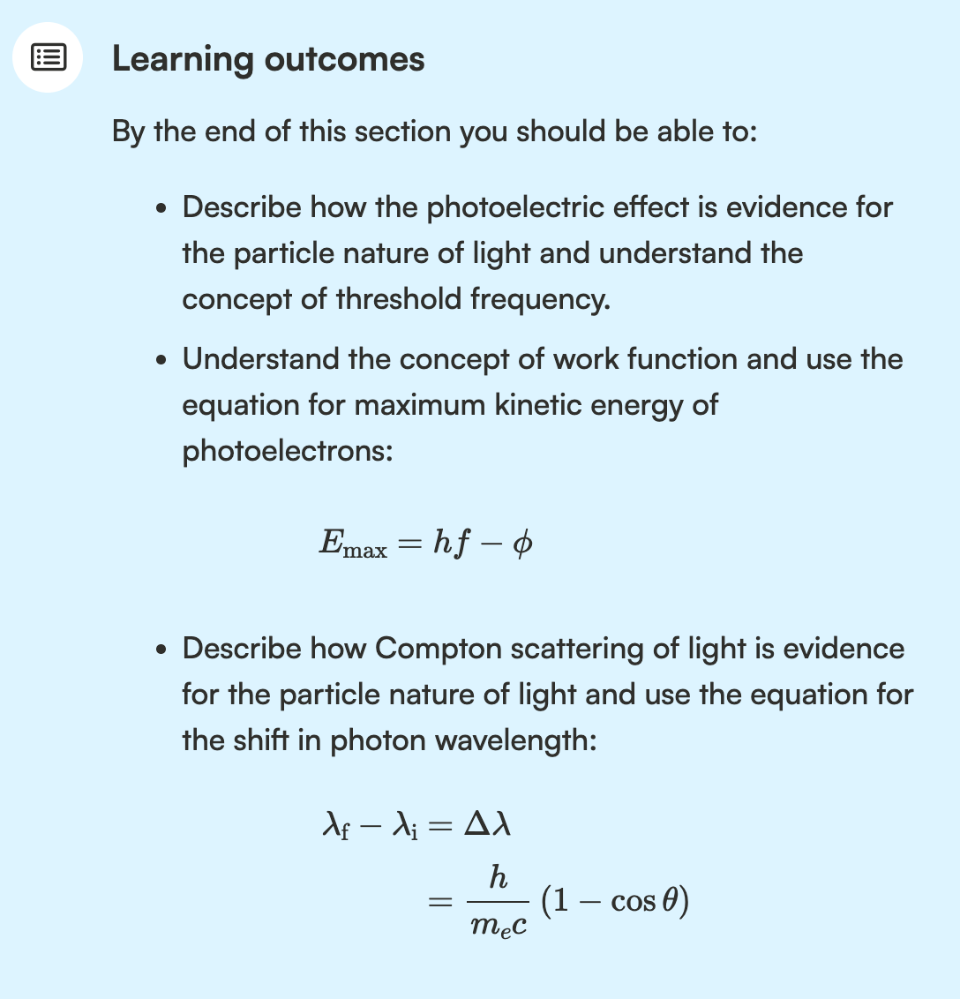

Slide 4
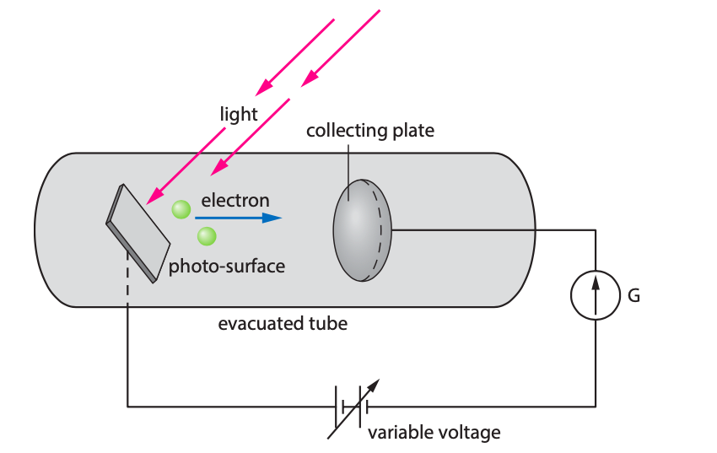
The Photoelectric Effect
Use the photoelectric effect applet and explain why this is evidence for the particle nature of light.
Explain what is the threshold frequency.
What happens to the current if you change the frequency of the light?
What happens to the current if you change the intensity of light?
Draw a diagram of voltage versus current for this setup.
What is the stopping voltage?

Slide 5
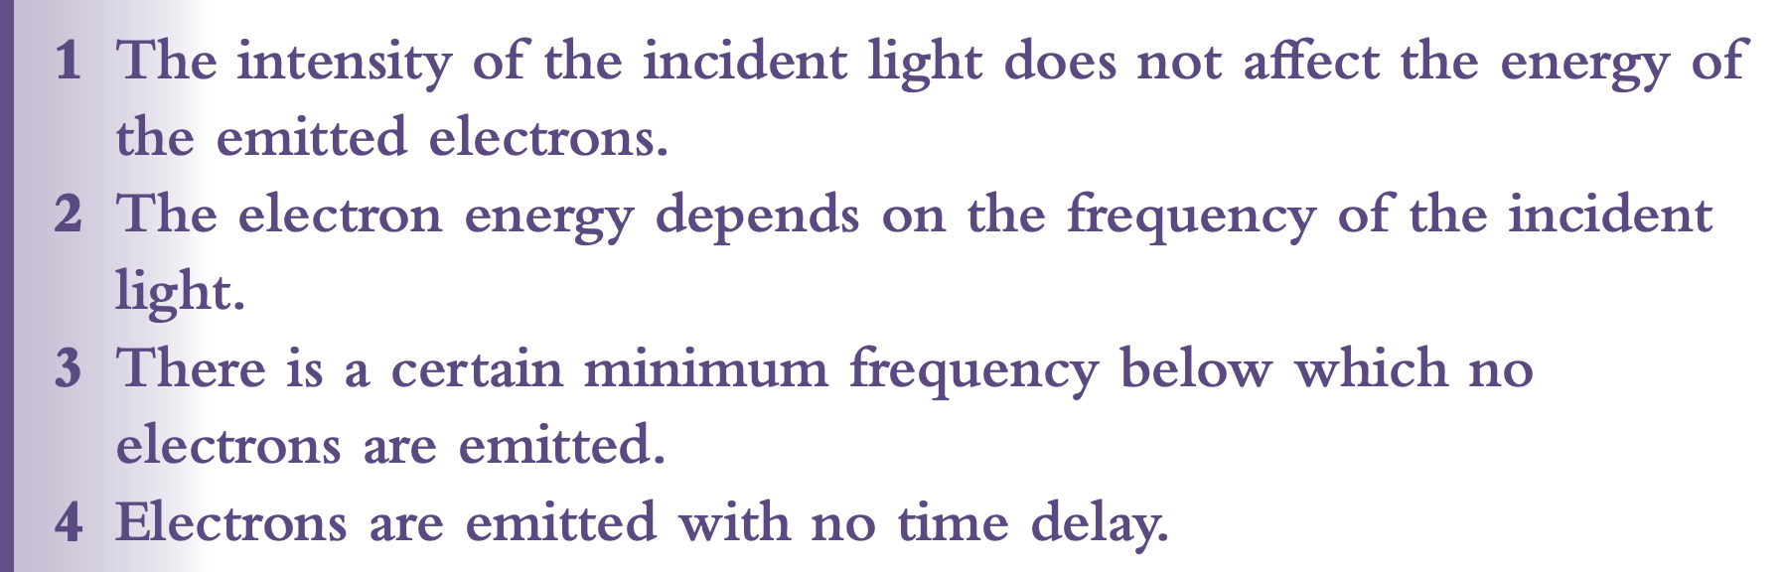
Photoelectric Effect

Slide 6
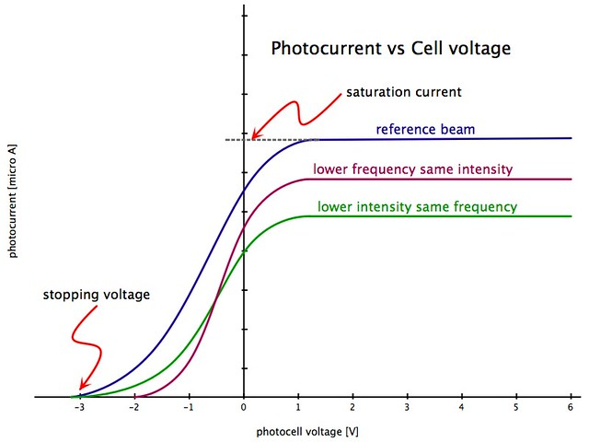
The Photoelectric Effect

Slide 7
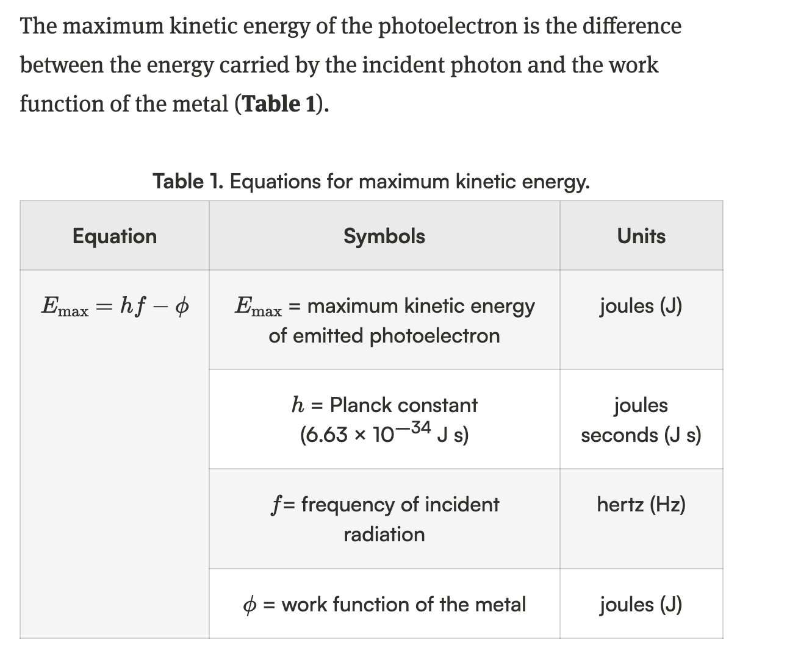
Photoelectric Effect

Slide 8
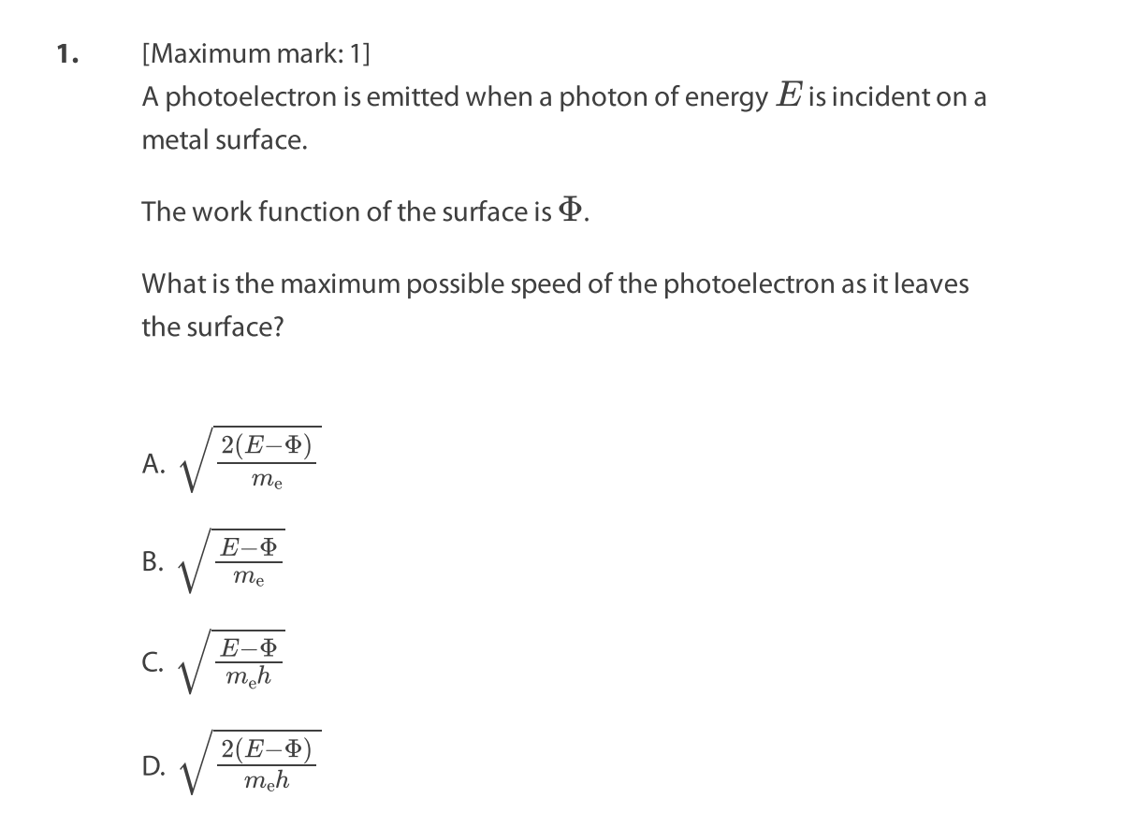
Photoelectric Effect
Paper questions E.2:
1, 3, 4, 7

Slide 9
“God does not play dice”

Slide 10
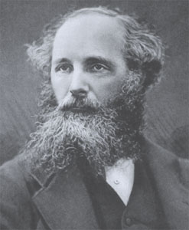
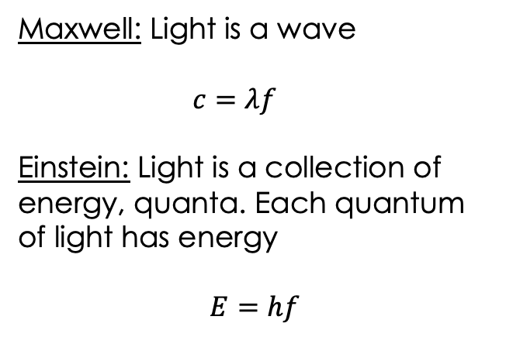
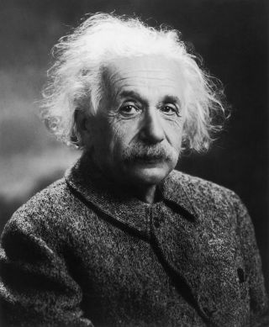
The interaction of matter with radiation
Only use this for fotons!!!

Slide 11
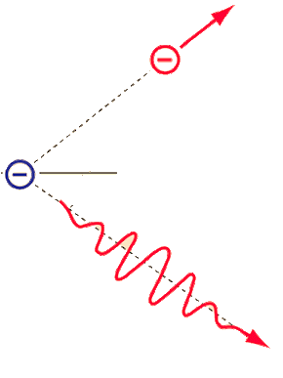
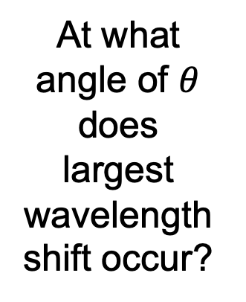
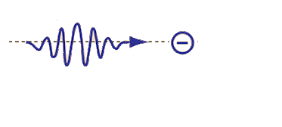

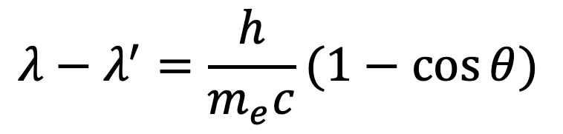
Compton Scattering
Recoil
electron
Incident
photon
Target electron
at rest
Compton wavelength

Slide 12
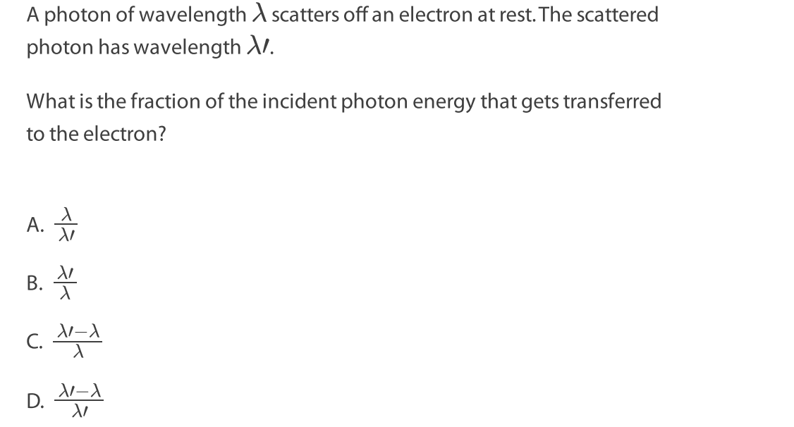
Compton Scattering
Recoil
electron
Incident
photon
Target electron
at rest
Paper questions E.2: 10, 15, 17
Compton wavelength

Slide 13
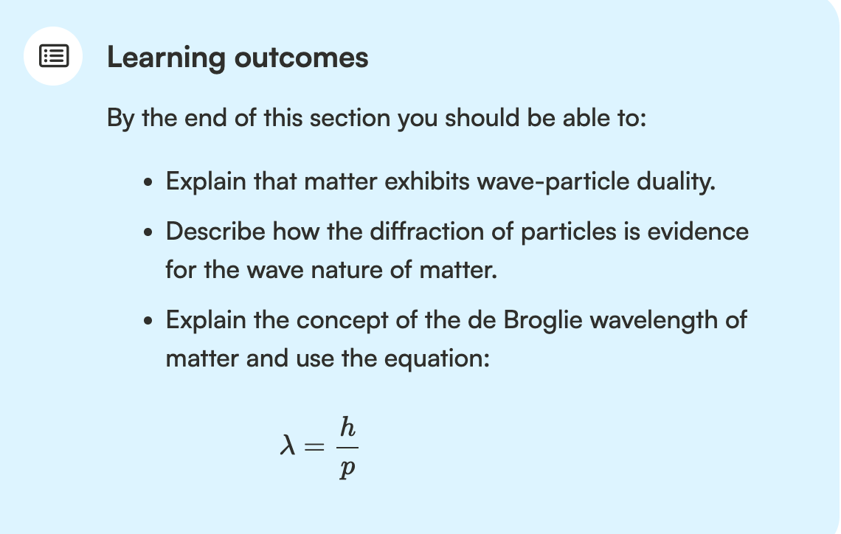
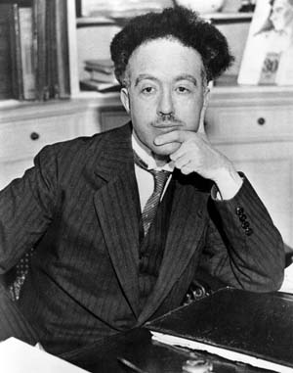
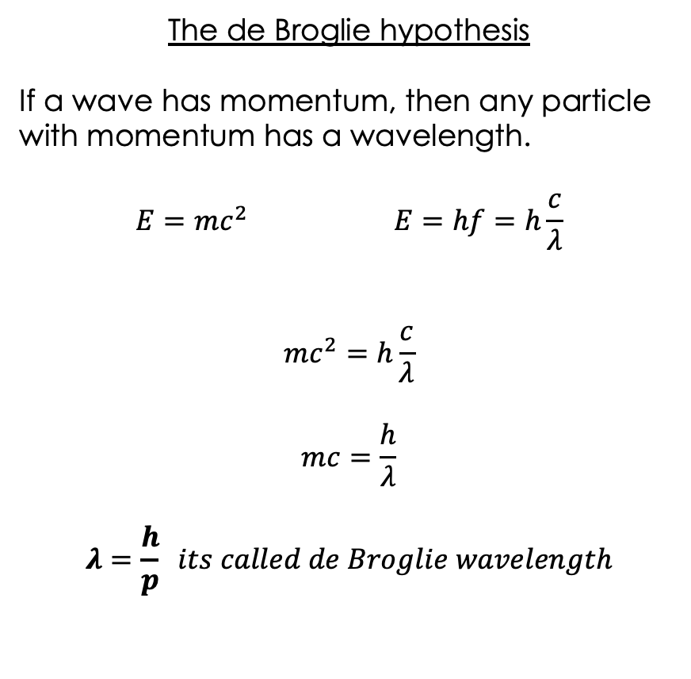
Matter Waves - Duality of Matter

Slide 14
Matter Waves - Duality of Matter

Slide 15
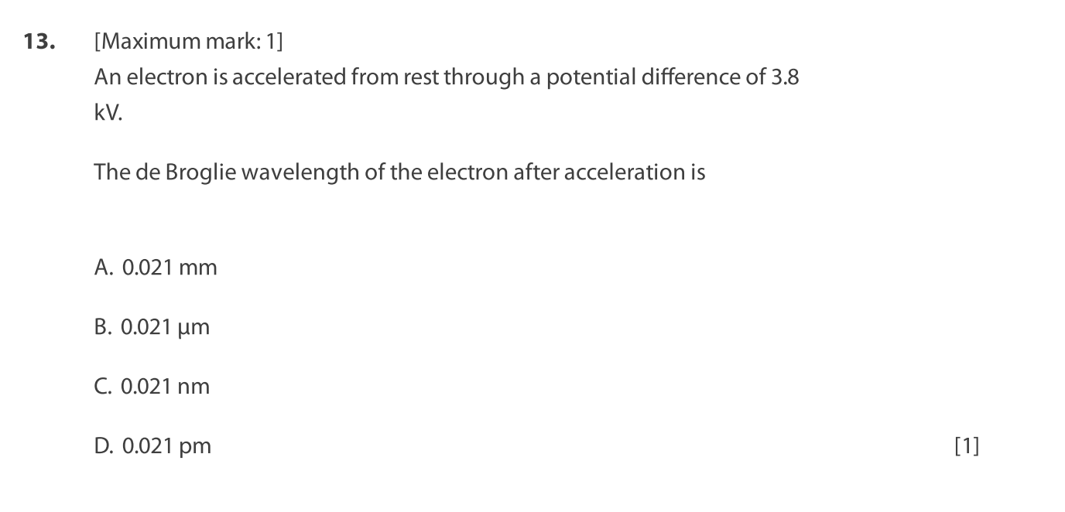
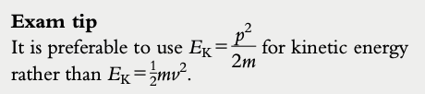
Paper questions E.2: 11, 12, 14, 16
Keep in mind that Etotal = hf

